Slide 1

Instagram
Influencer Marketing
Research
Mansukh Kaur
2017 CSC 1048

Slide 2
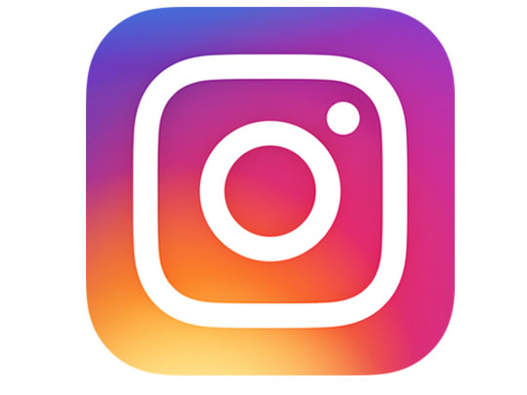
Instagram
Instagram is one of most used social media app around the globe with a billion active users. It was launched in October,2010 by Kevin Systrom and Mike Krieger as photo and video-sharing social networking service.

Slide 3
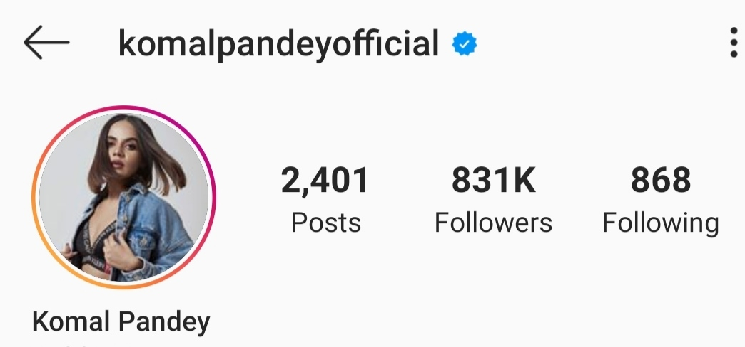
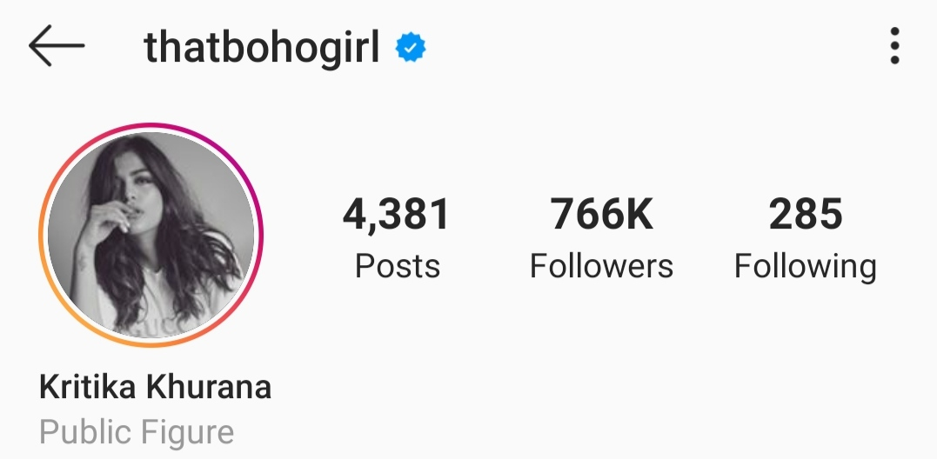
Instagram Influencers
People have grown their businesses and even themselves as a brand on Instagram. Individuals having a noticeable following are approached by brands to promote products and services on their page.

Slide 4
Instagram Influencers
The enagagement on Influencer’s page is turned into brand’s clients.
The engagement is the number of likes/comments/views/responses/shares/saveson the post or stories of the influencer.

Slide 5
Instagram Influencers
To track this, brand usually asks the influencer to add an hashtag to the captions of post and stories.
These hashtags ease the access of sponsored posts for the brand

Slide 6
Influencer Marketing Research

Slide 7
This research aims to find a predictive model to approximate the conversion rate for a brand based on the fact
“more the engagement,
higher the conversion.”

Slide 8
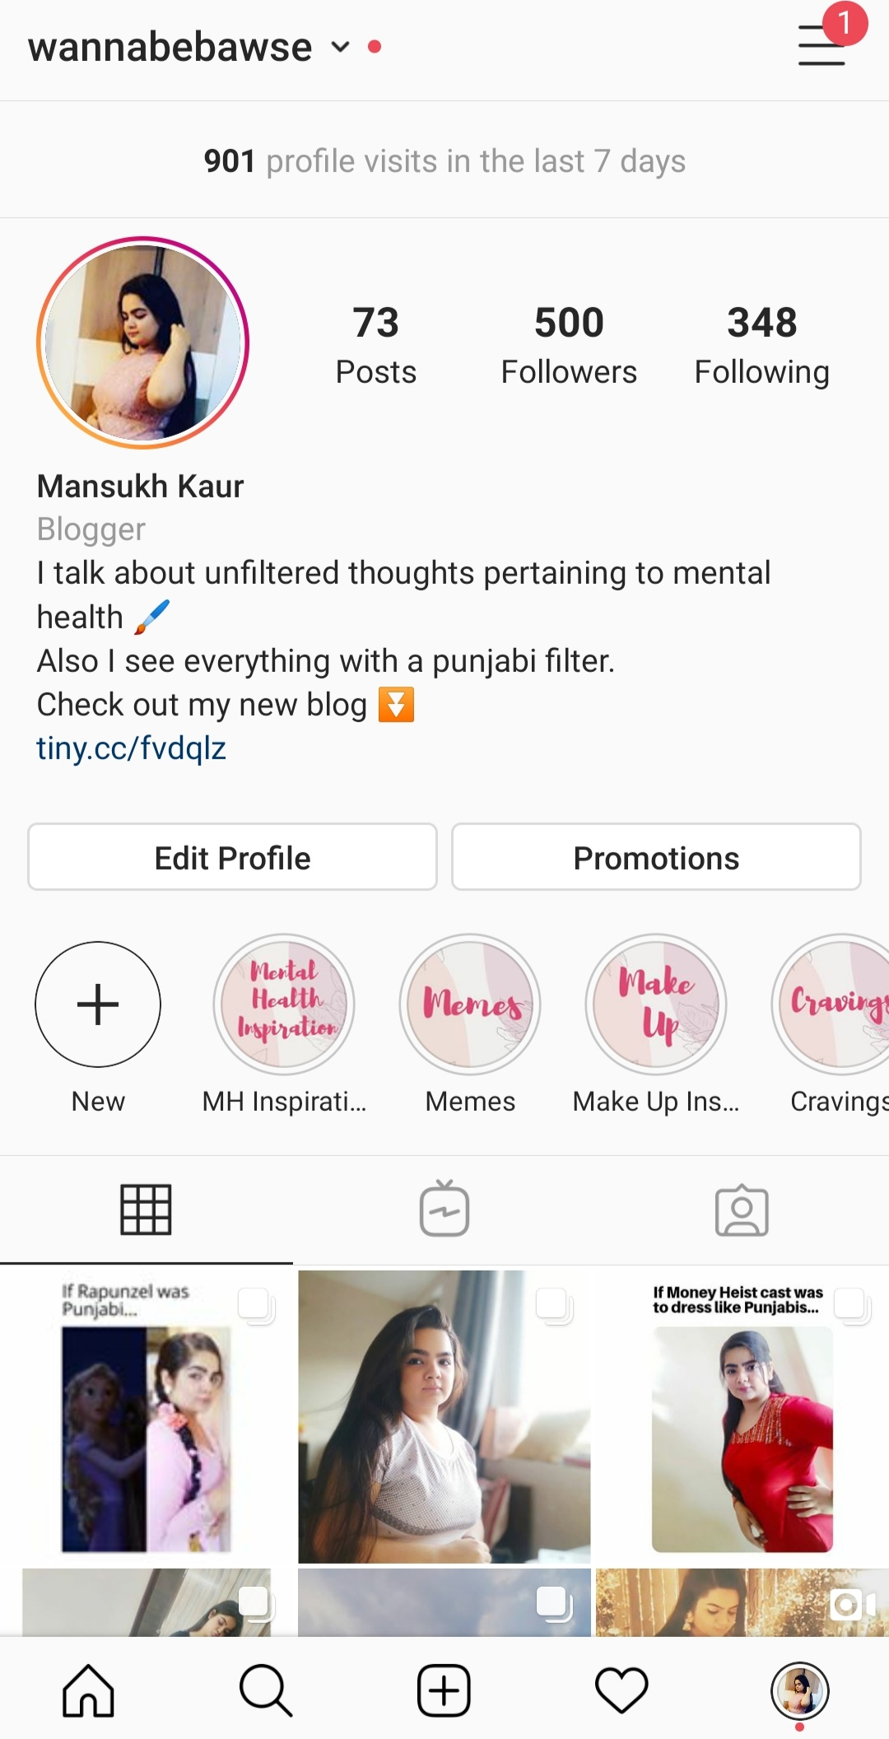
Motivation behind the Project
Last year I started my own Instagram Page, I have been following influencers since 3-4 years. I always wondered how brand deals work. My curiosity motivated me to take up the project.

Slide 9

Data Extraction
PhantomBuster is an online tool for data extraction and automation.

Slide 10
It provides various “phantoms” which are used to output .csv and .json data files upon being provided with a googlesheet as an input.

Slide 11
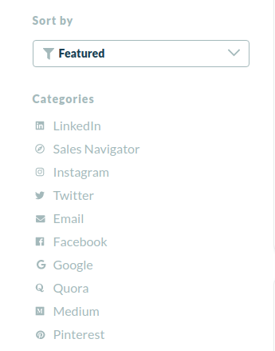
Phantom Buster is an impressive tool that can extract data from leading services.

Slide 12
Data Extraction
Instagram does not offer an official API for data extraction. Also, scraping data directly from the website is quite laborious task is they have encrypted each and every detail.

Slide 13
I used Instagram Profile Scraper phantom. I provided a googlesheet having 20 hashtags.
In an hour 100 recent posts (approx.) relevant to each hashtag along with corresponding data were scraped.

Slide 14
Data Cleaning Process

Slide 15
Variables available
postUrl
profileUrl
Username
Full name
Comment count
Like count
Publishing date
Image URL
Post ID
Query (hastag associated)
Time stamp
Liked by Viewer
Is Side car (true if multiple images available)
Type
View count
Location
Location Id
Caption
Tagged username 1-25
Tagged Full Name 1-25

Slide 16
Since our research is based on Instagram Posts and its data such as Hashtags used in caption, likes and comments, whether multiple images are there in post, or the post is a Video.
We do not need URLs, locationIds, PostId and Tagged Users details.
Also, since username is unique, we do not even need the full names of the influencers.

Slide 17
Since the data is extracted on the basis of hashtags, we do not even need captions.
Lastly, the timestamp refers to time and data when data was scraped, making it useless for us.

Slide 18
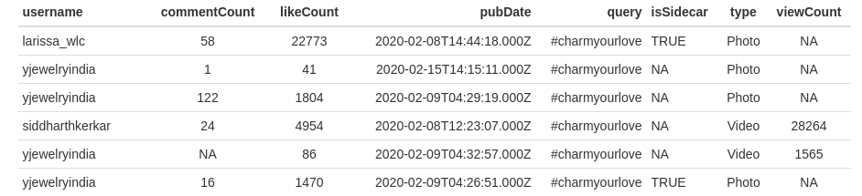
The data set (now data frame) looks like this -

Slide 19
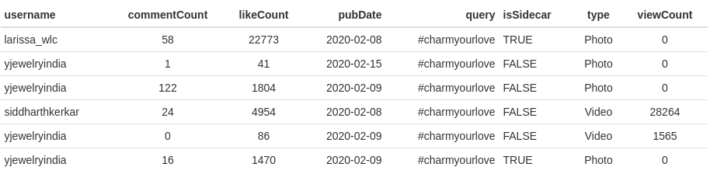
Now, after changing NA values to either 0 or FALSE and formatting Publishing Date,
The dataframe looks like :

Slide 20
The Hypothesis

Slide 21
Let’s hypothesize that conversion rate for a brand is related to number of posts along with frequency of posts made using brand’s hashtag.
We cannot directly measure the conversion, but we can measure the impact in terms of engagement made with the posts containing brand’s hashtag.

Slide 22
We can say that posts, pubDate, likeCount, commentCount, viewCount are predictors and the combined engagement is the response variable.
Ha= the predictors are related to engagement
Ho= the predictors and engagement are not related at all

Slide 23
For example : #facetimewithgarnier is a promotional hashtag by Garnier for their new range of facemasks
The conversion rate for Garnier is the sale of the sheetmasks.
The increase in sales will depend upon the engagement generated by influencers who will be posting about the masks with #facetimewithgarnier.
The enagagnment will be in the form of Likes, Comments and Views(if videos are uploaded)

Slide 24
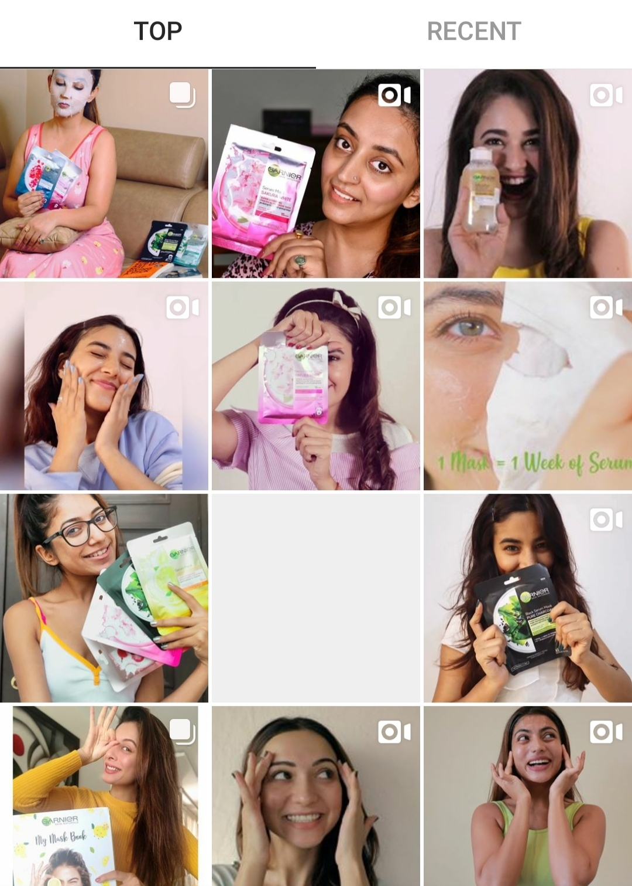
Some posts containing
#facetimewithgarnier

Slide 25
The Analytics

Slide 26
Starting with looking at our data,
let us first analyse 2 main components of research-
The Hashtags and the Number of Posts
corresponding to each hashtag

Slide 27
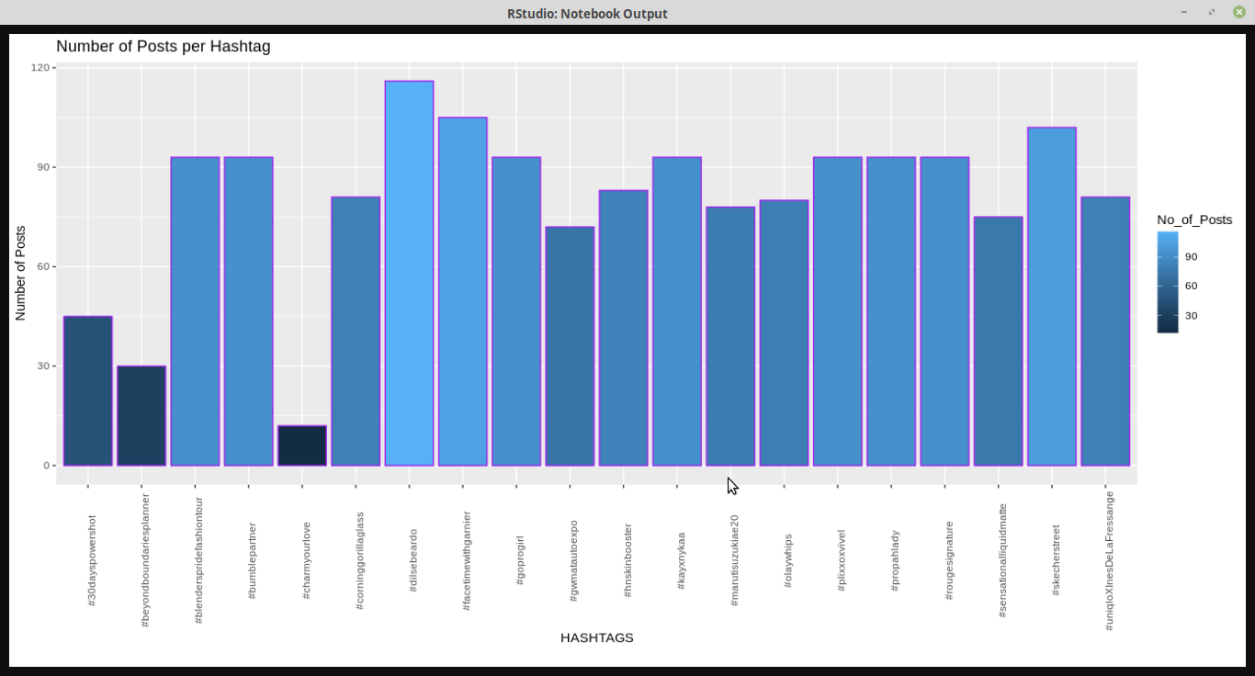

Slide 28
Posts can be of 2 types-
Photo and Video
Let us analyse the general trend of engagement for both of these regardless of Hashtags

Slide 29
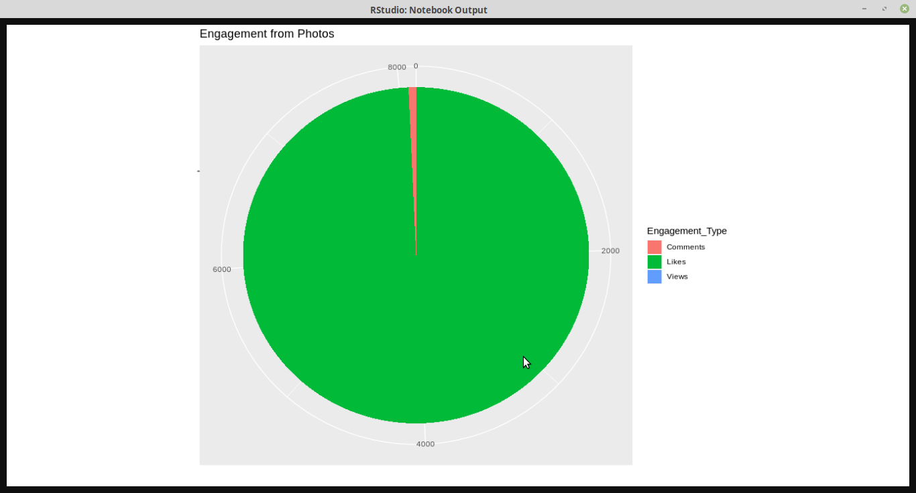

Slide 30
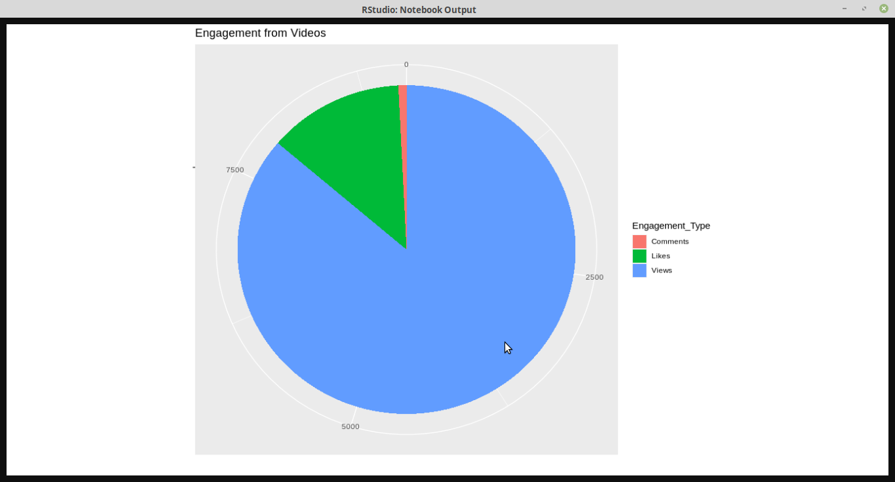

Slide 31
These Pie Charts are made up of average Likes, Comments, and Views of all the posts for each post type -Photo and Video.
We can observe that Views of a Video can drastically change the overall engagement of the post.
Also, an observation can be made about Photo post’s engagement.
Most engagement of a Photo is through its Likes.
Comments are somewhat least engaging aspect of a Post.

Slide 32
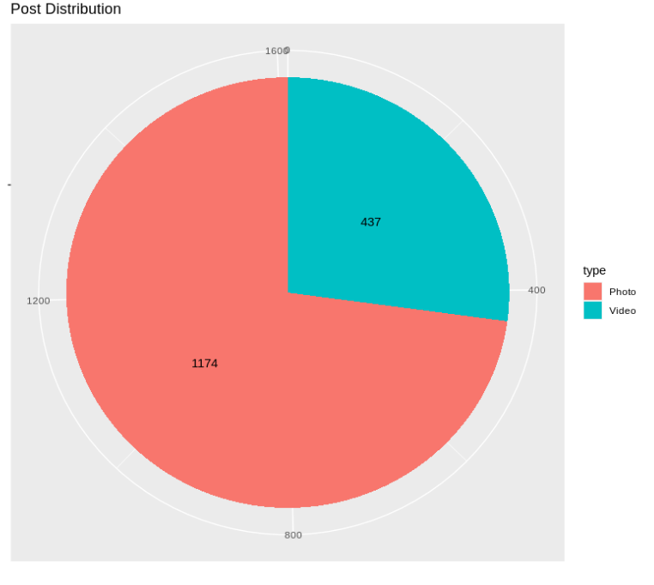
We should know how many Photo and Video Post we are working on.

Slide 33
Moving on, Let us analyse the data on the basis of each Hashtag.
First of all, consider the Likes and Comments of Photo posts of all the Hashtags.

Slide 34
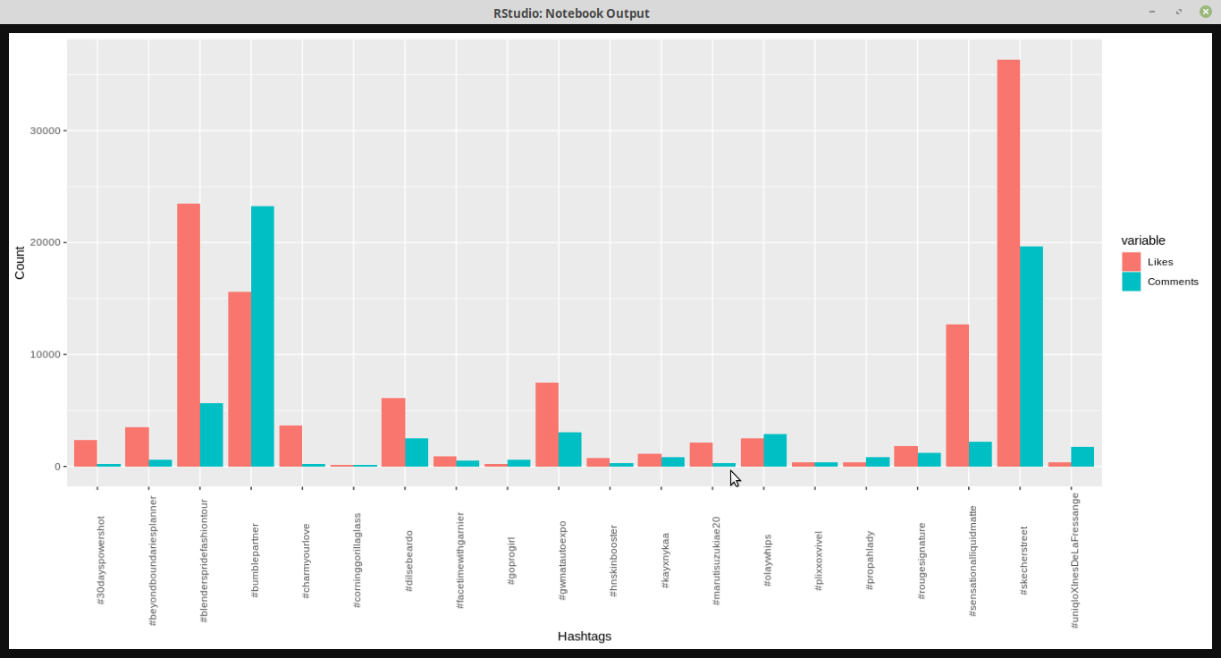

Slide 35
Clearly we can notice that #sketchstreet has maximum engagement whereas #charmyourlove has minimum engagement for their Photo Posts.

Slide 36
Now, consider the Likes and Comments of Video posts of all the Hashtags.

Slide 37
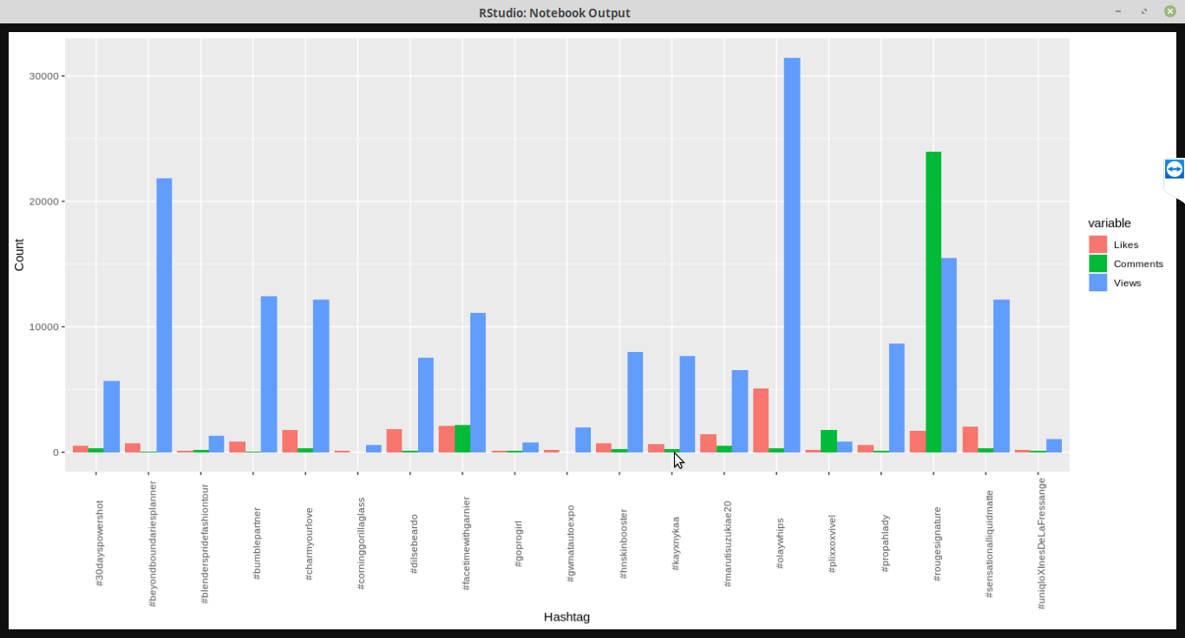

Slide 38
The results of maximum and minimum engagement for Video posts are not similar to Photo posts.
Here, #olaywhips and #corningglass have maximum and minimum engagements respectively.
As discussed earlier Views spike the engagement.
Also, the number of Comments for the #rouguesignature is strangely very high.

Slide 39
Let us visualise Total Engagement for all Hashtags.

Slide 40
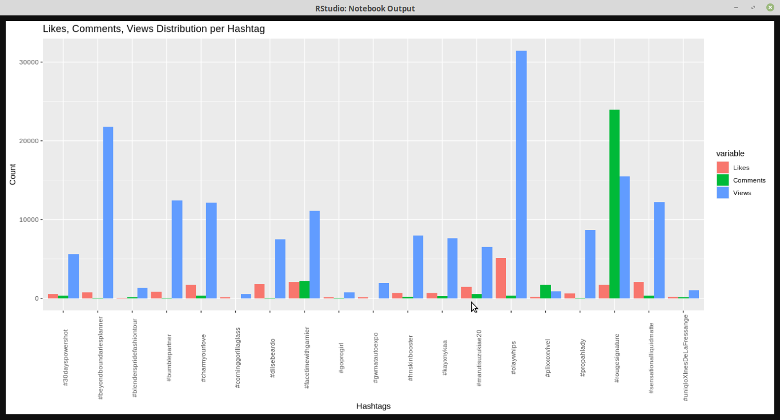

Slide 41
We can observe
Maximum Engagement : #olaywhips
Minimum Engagement: #corninggorillaglass
Notably,the result of the total engagement of a Hashtag
is similar to the engagement generated by Video Posts.

Slide 42
Let us, look at the timeline of posts for each Hashtag.

Slide 43
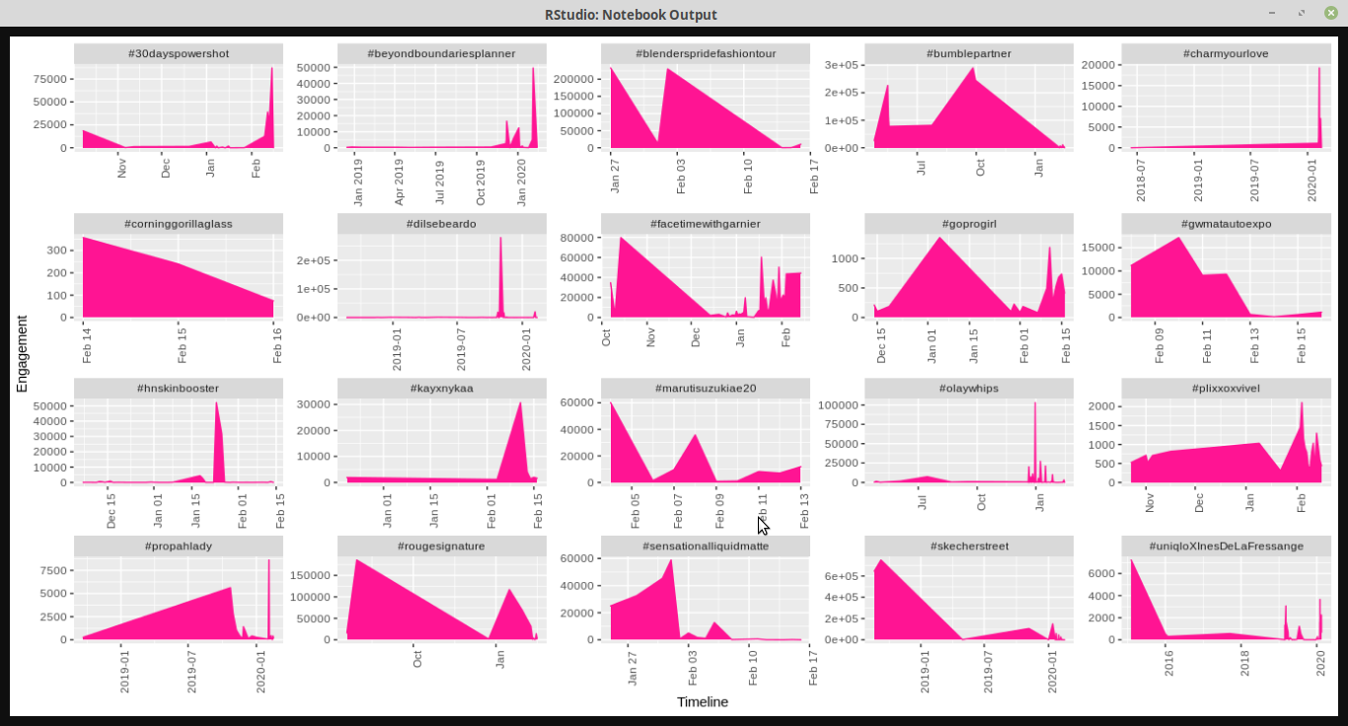

Slide 44
We can note the some brands were able to generate huge engagement in short amount of time, on the other hand some maintained the engagement at a steady level over past years.
Let’s find a relationship between total engagement and number of days consumed to create these engagements.

Slide 45
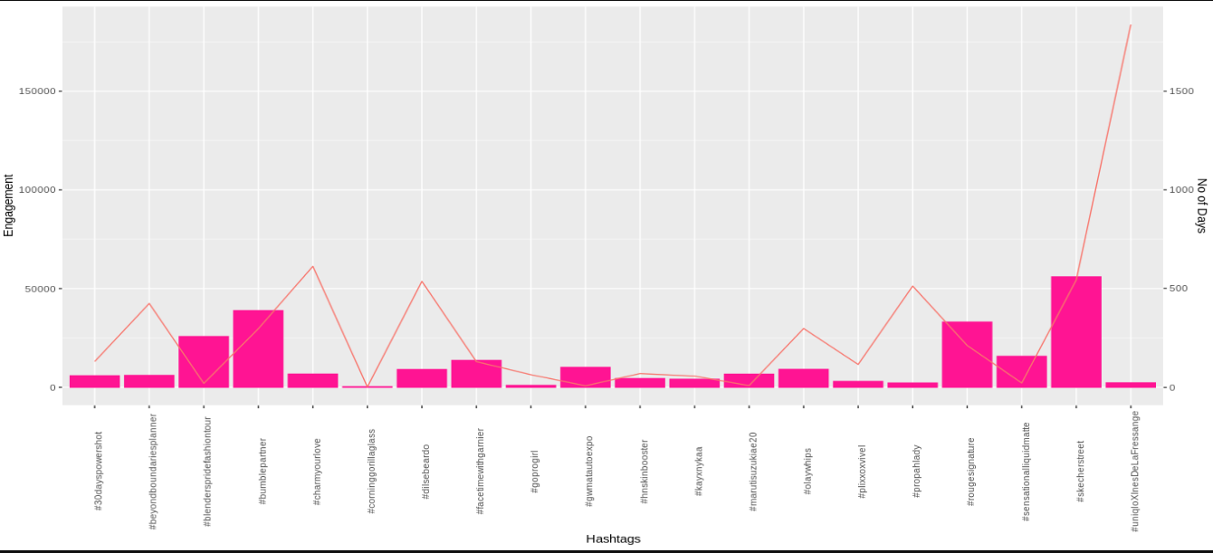

Slide 46
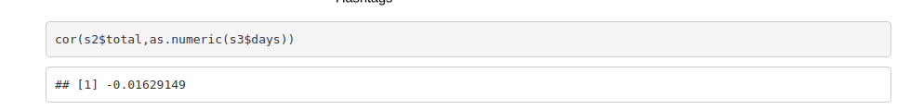
Here, the orange line represents number of days and the bars represent engagement.
Visually no relationship can be observed between days spend to generate engagement and engagement it self
This can be proved mathematically by

Slide 47
Following observations can be made from Engagement Vs Number of Days chart:
The engagement generated from a particular hashtag does not depend upon number of posts but on the total number of likes+comments+views.
The engagement generated does not even depend on number of days but the frequency of posts made in a particular span having higher likes+comments+views.

Slide 48
Conclusion

Slide 49
For a brand, the following measures should be taken into consideration while predicting the engagement of their hashtag.
The posts should be able to generate huge engagement in less time span.
The total engagement depends on the video posts generated, therefore, video posts should be preferred.
The frequency of posts mentioned in (1) should be high.

Slide 50
Since we are able to find the relationship between our predictors and response variable. We will reject Ho.
Therefore, we are able to predict the engagement for a particular Hashtag.
__X__

Slide 51
The Future Scope

Slide 52
This project can be endlessly elaborated. The details of the influencer can be brought into picture, such as his/her category, number of sponsored post, most importantly the following. This will provide us the bigger picture of “engagement”.
Live promotions can be monitored on daily basis.
The Hashtags can be classified based on location of the post.

Slide 53
References

Slide 54
The GoogleClassroom group
The ggplot2 cheatsheet
The dplyr cheatsheet
Udemy free courses
R Cookbook

Slide 55
SlidesCarnival icons are editable shapes.
This means that you can:
Resize them without losing quality.
Change fill color and opacity.
Change line color, width and style.
Isn’t that nice? :)
Examples:

